Slide 1
Unpaired Image-to-Image Translation using Cycle-Consistent Adversarial Networks
lecturer: hzzhoulifeng
Notes:
http://www.inference.vc/my-summary-of-adversarial-training-nips-workshop/
I should follow this https://epsilon-lee.github.io/blog/GANs-Basics.html
F-GAN
W-GAN x 2
LS-GAN
Loss sentisive
EB-GAN

Slide 2
Unpaired Image-to-Image Translation using Cycle-Consistent Adversarial Networks
Content:
Issues about Generative Adversarial Network(GAN)
Issues about CycleGan
Notes:
http://www.inference.vc/my-summary-of-adversarial-training-nips-workshop/
I should follow this https://epsilon-lee.github.io/blog/GANs-Basics.html
F-GAN
W-GAN x 2
LS-GAN
Loss sentisive
EB-GAN

Slide 3
Generative Adversarial Network (GAN)
Author: Ian Goodfellow
Paper: https://arxiv.org/abs/1701.00160
Notes:
http://www.inference.vc/my-summary-of-adversarial-training-nips-workshop/
I should follow this https://epsilon-lee.github.io/blog/GANs-Basics.html
F-GAN
W-GAN x 2
LS-GAN
Loss sentisive
EB-GAN

Slide 4
Review

Slide 5
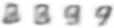
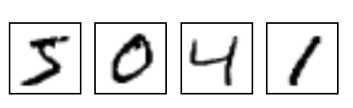
GAN - Discriminator
NN
Generator
v1
Randomly sample a vector
0
0
0
0
Real images:
1
1
1
1
image
Discri-minator
v1
(real or fake)
1/0

Slide 6
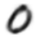
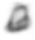
GAN - Generator
Randomly sample a vector
NN
Generator
v1
Updating the parameters of generator
v2
The output be classified as “real” (as close to 1 as possible)
Generator + Discriminator = a network
Discri-minator
v1
Using gradient descent to update the parameters in the generator, but fix the discriminator
1.0
0.13

Slide 7











GAN – 二次元人物頭像鍊成
Source of images: https://zhuanlan.zhihu.com/p/24767059
DCGAN: https://github.com/carpedm20/DCGAN-tensorflow

Slide 8
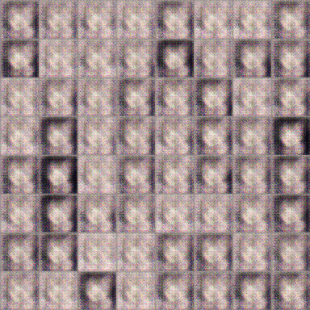
GAN – 二次元人物頭像鍊成
100 rounds

Slide 9
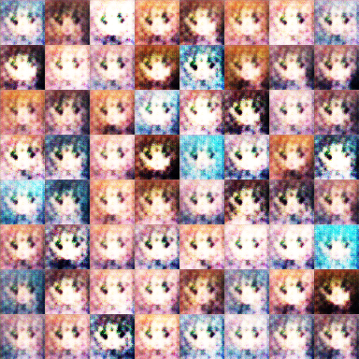
GAN – 二次元人物頭像鍊成
1000 rounds

Slide 10
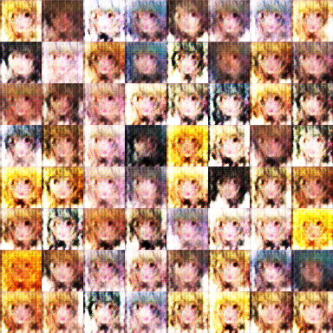
GAN – 二次元人物頭像鍊成
2000 rounds

Slide 11
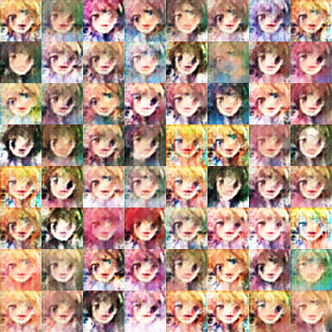
GAN – 二次元人物頭像鍊成
5000 rounds

Slide 12
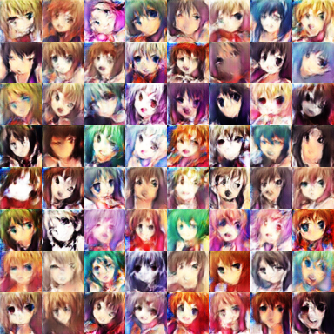
GAN – 二次元人物頭像鍊成
10,000 rounds

Slide 13
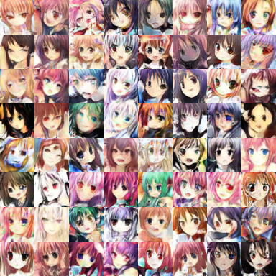
GAN – 二次元人物頭像鍊成
20,000 rounds

Slide 14
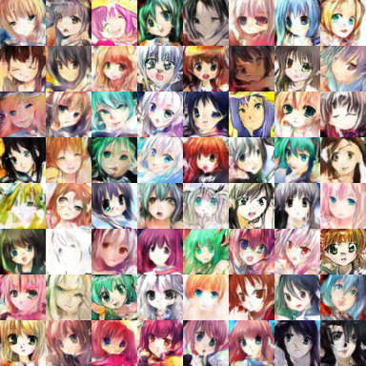
GAN – 二次元人物頭像鍊成
50,000 rounds

Slide 15
Basic Idea of GAN

Slide 16
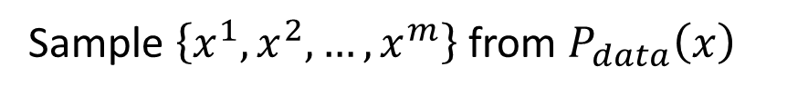
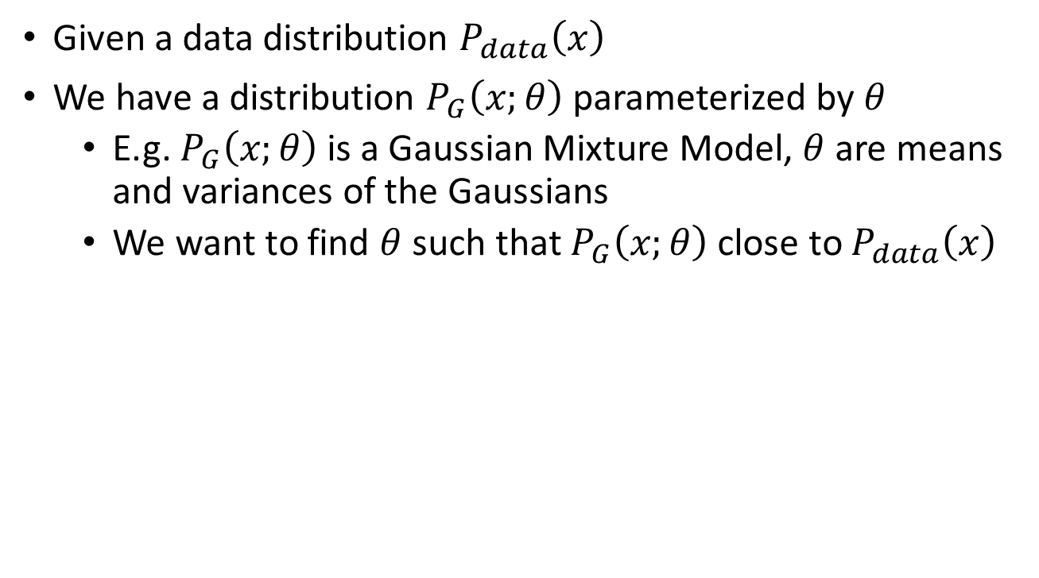

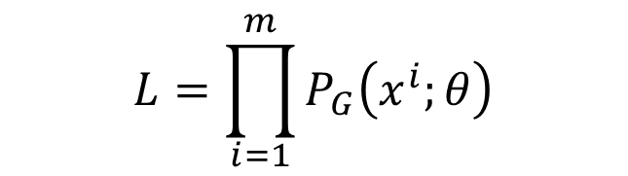
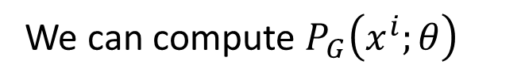
Maximum Likelihood Estimation
Given a data distribution $P_{data}\left(x\right)$
We have a distribution $P_{G}\left(x;θ\right)$ parameterized by $θ$
E.g. $P_{G}\left(x;θ\right)$ is a Gaussian Mixture Model, $θ$ are means and variances of the Gaussians
We want to find $θ$ such that $P_{G}\left(x;θ\right)$ close to $P_{data}\left(x\right)$
Sample $\left\{x^{1},x^{2},…,x^{m}\right\}$ from $P_{data}\left(x\right)$
We can compute $P_{G}\left(x^{i};θ\right)$
Likelihood of generating the samples
$$L=\prod_{i=1}^{m}{P_{G}\left(x^{i};θ\right)}$$
Find $θ^{∗}$ maximizing the likelihood

Slide 17
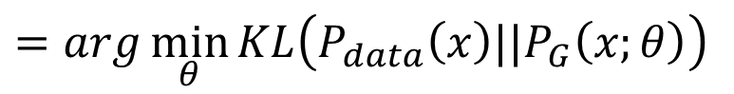
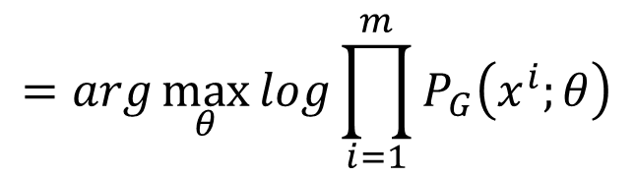
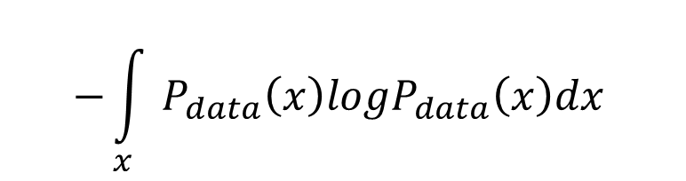
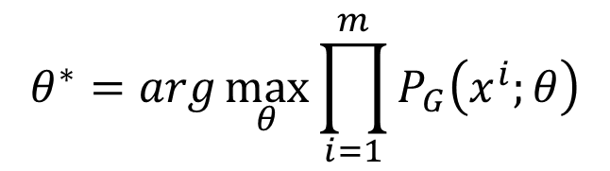
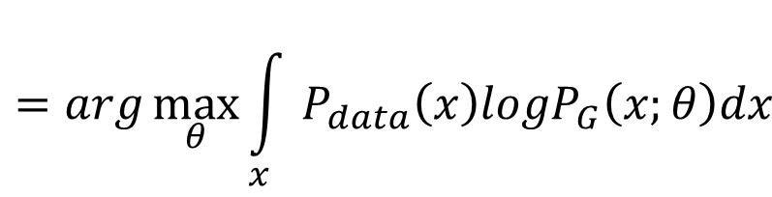
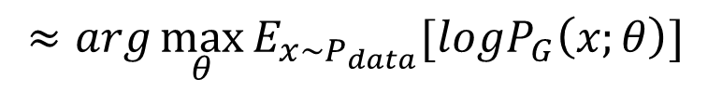
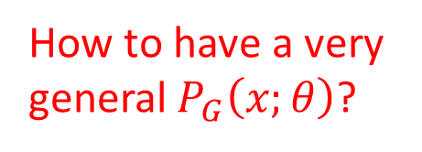
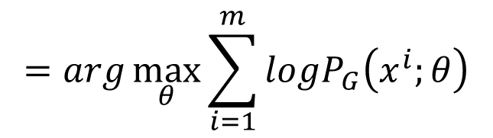
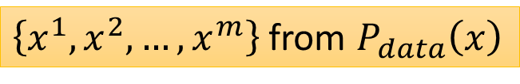
Maximum Likelihood Estimation
$$θ^{∗}=arg\max_{θ}{\prod_{i=1}^{m}{P_{G}\left(x^{i};θ\right)}}$$
$$=arg\max_{θ}{log\prod_{i=1}^{m}{P_{G}\left(x^{i};θ\right)}}$$
$$=arg\max_{θ}{\sum_{i=1}^{m}{logP_{G}\left(x^{i};θ\right)}}$$
$\left\{x^{1},x^{2},…,x^{m}\right\}$ from $P_{data}\left(x\right)$
$$≈arg\max_{θ}{E_{x\sim P_{data}}[logP_{G}\left(x;θ\right)] }$$
$$=arg\max_{θ}{\int_{x}{P_{data}\left(x\right)logP_{G}\left(x;θ\right)dx} }$$
$$−{\int_{x}{P_{data}\left(x\right)logP_{data}\left(x\right)dx} }$$
How to have a very general $P_{G}\left(x;θ\right)$?
$$=arg\min_{θ}{KL\left(P_{data}\left(x\right)||P_{G}\left(x;θ\right)\right) }$$

Slide 18
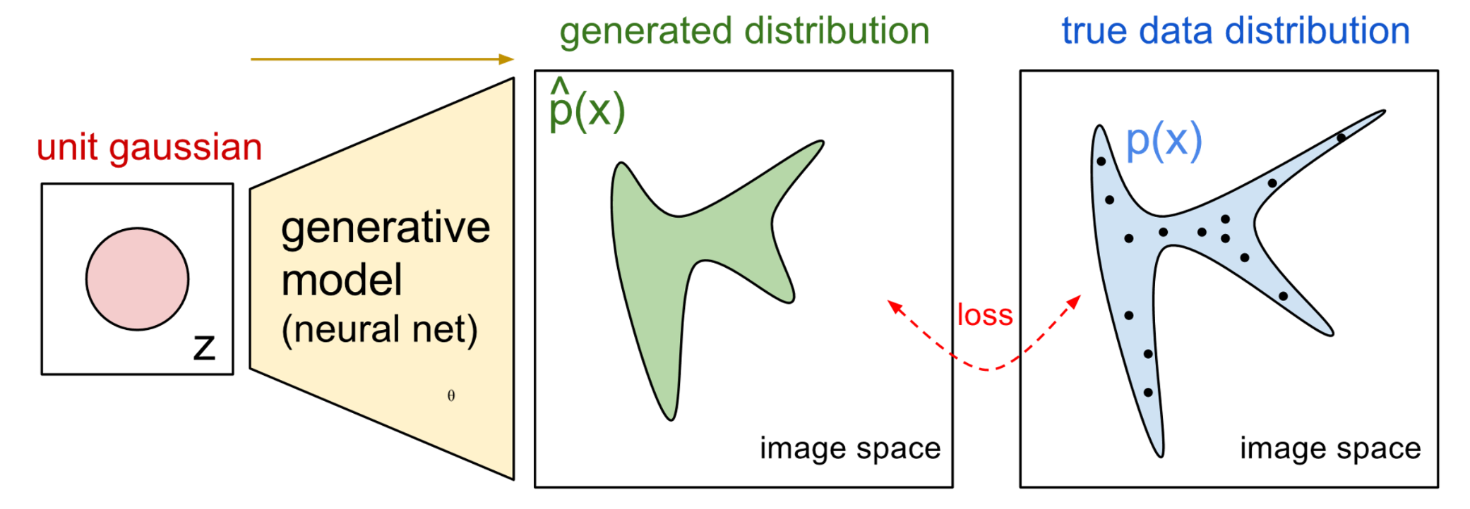



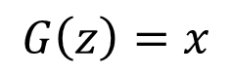
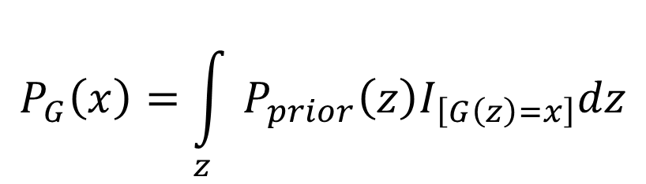
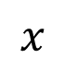
Now $P_{G}\left(x;θ\right)$ is a NN
$$P_{G}\left(x;θ\right)$$
$$P_{data}\left(x\right)$$
$$G\left(z\right)=x$$
$$x$$
$$P_{G}\left(x\right)=\int_{z}{P_{prior}\left(z\right)I_{\left[G\left(z\right)=x\right]}dz}$$
It is difficult to compute the likelihood.
https://blog.openai.com/generative-models/

Slide 19
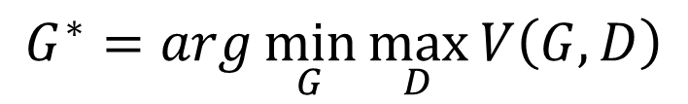
Basic Idea of GAN
Generator G
G is a function, input z, output x
Given a prior distribution P_{prior}(z), a probability distribution P_{G}(x) is defined by function G
Discriminator D
D is a function, input x, output scalar
Evaluate the “difference” between P_{G}(x) and P_{data}(x)
There is a function V(G,D).
Hard to learn by maximum likelihood
$$G^{∗}=arg\min_{G}{\max_{D}{V\left(G,D\right)}}$$

Slide 20
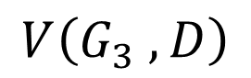
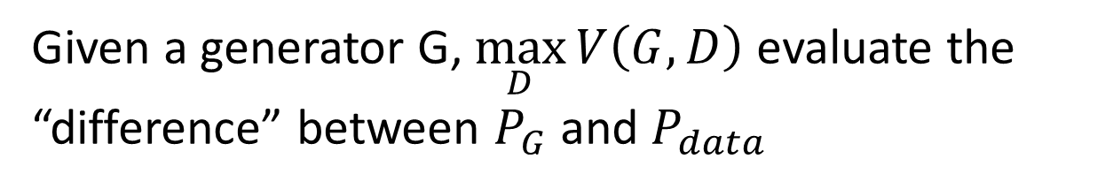
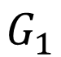
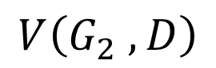
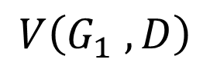
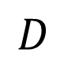
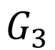
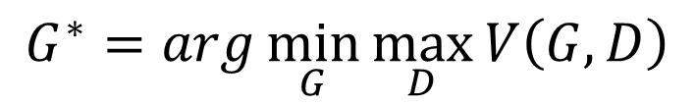
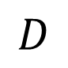
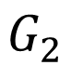
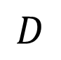
Basic Idea
$$G^{∗}=arg\min_{G}{\max_{D}{V\left(G,D\right)}}$$
$$V=E_{x∼P_{data}}\left[logD\left(x\right)\right]+E_{x∼P_{G}}\left[log\left(1−D\left(x\right)\right)\right]$$
Given a generator G, $\max_{D}{V\left(G,D\right)}$ evaluate the “difference” between $P_{G}$ and $P_{data}$
Pick the G defining $P_{G}$ most similar to $P_{data}$
$$V\left(G_{1} ,D\right)$$
$$V\left(G_{2} ,D\right)$$
$$V\left(G_{3} ,D\right)$$
$$D$$
$$D$$
$$D$$
$$G_{1}$$
$$G_{2}$$
$$G_{3}$$

Slide 21
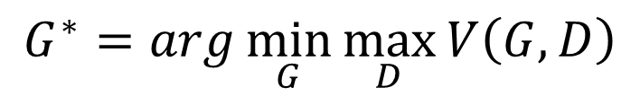
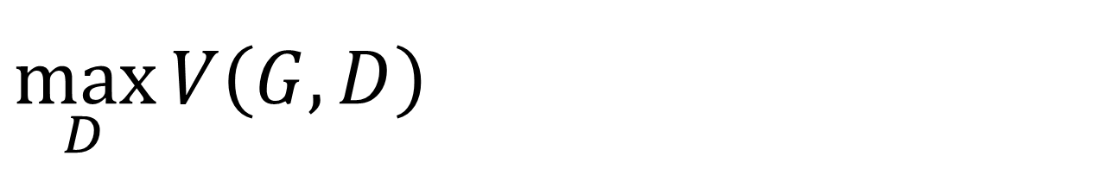
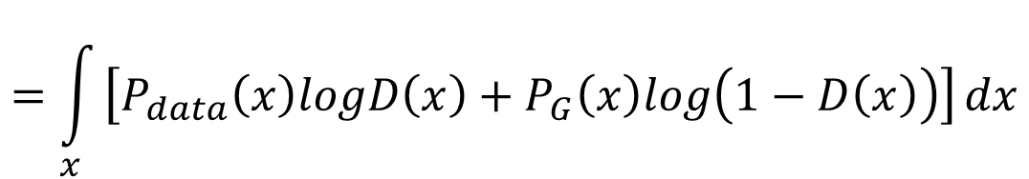
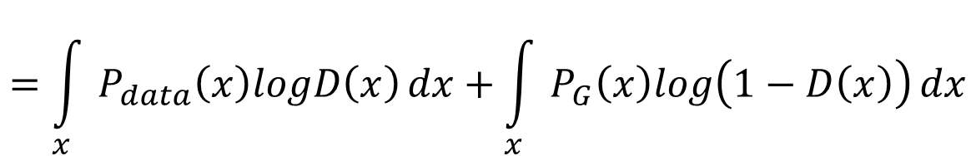
$$\max_{D}{V\left(G,D\right)}$$
$$G^{∗}=arg\min_{G}{\max_{D}{V\left(G,D\right)}}$$
Given G, what is the optimal D* maximizing
Given x, the optimal D* maximizing
$$V=E_{x∼P_{data}}\left[logD\left(x\right)\right]+E_{x∼P_{G}}\left[log\left(1−D\left(x\right)\right)\right]$$
$$=\int_{x}{P_{data}\left(x\right)logD\left(x\right)}dx+\int_{x}{P_{G}\left(x\right)log\left(1−D\left(x\right)\right)}dx$$
$$=\int_{x}{\left[P_{data}\left(x\right)logD\left(x\right)+P_{G}\left(x\right)log\left(1−D\left(x\right)\right)\right]}dx$$
Assume that D(x) can have any value here
$$P_{data}\left(x\right)logD\left(x\right)+P_{G}\left(x\right)log\left(1−D\left(x\right)\right)$$

Slide 22
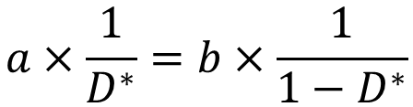
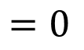
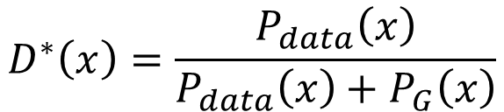
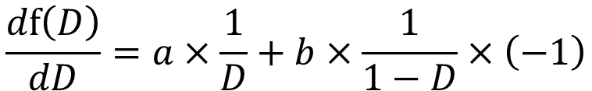
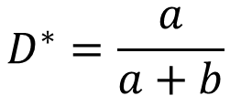
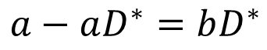


$$\max_{D}{V\left(G,D\right)}$$
$$G^{∗}=arg\min_{G}{\max_{D}{V\left(G,D\right)}}$$
Given x, the optimal D* maximizing
Find D* maximizing:
$$P_{data}\left(x\right)logD\left(x\right)+P_{G}\left(x\right)log\left(1−D\left(x\right)\right)$$
a
D
b
D
$$f\left(D\right)=alog(D)+blog\left(1−D\right)$$
$$\frac{df\left(D\right)}{dD}=a×\frac{1}{D}+b×\frac{1}{1−D}×\left(−1\right)$$
$$=0$$
$$a×\frac{1}{D^{∗}}=b×\frac{1}{1−D^{∗}}$$
$$a×\left(1−D^{∗}\right)=b×D^{∗}$$
$$a−aD^{∗}=bD^{∗}$$
$$D^{∗}=\frac{a}{a+b}$$
$$D^{∗}\left(x\right)=\frac{P_{data}\left(x\right)}{P_{data}\left(x\right)+P_{G}\left(x\right)}$$
0 <
< 1
Notes:
sigmoid

Slide 23










$$\max_{D}{V\left(G,D\right)}$$
$$G^{∗}=arg\min_{G}{\max_{D}{V\left(G,D\right)}}$$
$$D_{1}^{∗}\left(x\right)=\frac{P_{data}\left(x\right)}{P_{data}\left(x\right)+P_{G_{1}}\left(x\right)}$$
$$D_{2}^{∗}\left(x\right)=\frac{P_{data}\left(x\right)}{P_{data}\left(x\right)+P_{G_{2}}\left(x\right)}$$
“difference” between $P_{G_{1}}$ and $P_{data}$
$$V\left(G_{1} ,D_{1}^{∗}\right)$$
$$D$$
$$D$$
$$D$$
$$V\left(G_{1} ,D\right)$$
$$V\left(G_{2} ,D\right)$$
$$V\left(G_{3} ,D\right)$$

Slide 24













$$\max_{D}{V\left(G,D\right)}$$
$$V=E_{x∼P_{data}}\left[logD\left(x\right)\right]$$
$$+E_{x∼P_{G}}\left[log\left(1−D\left(x\right)\right)\right]$$
$$\max_{D}{V\left(G,D\right)}$$
$$=V\left(G,D^{∗}\right)$$
$$D^{∗}\left(x\right)=\frac{P_{data}\left(x\right)}{P_{data}\left(x\right)+P_{G}\left(x\right)}$$
$$=E_{x∼P_{data}}\left[log\frac{P_{data}\left(x\right)}{P_{data}\left(x\right)+P_{G}\left(x\right)}\right]$$
$$+E_{x∼P_{G}}\left[log\frac{P_{G}\left(x\right)}{P_{data}\left(x\right)+P_{G}\left(x\right)}\right]$$
$$\frac{1}{2}$$
$$=\int_{x}{P_{data}\left(x\right)log\frac{P_{data}\left(x\right)}{P_{data}\left(x\right)+P_{G}\left(x\right)}}dx$$
$$\frac{1}{2}$$
2
$$+\int_{x}{P_{G}\left(x\right)log\frac{P_{G}\left(x\right)}{P_{data}\left(x\right)+P_{G}\left(x\right)}}dx$$
$$+2log\frac{1}{2}$$
$$−2log2$$
2
Notes:
Converge

Slide 25






$$\max_{D}{V\left(G,D\right)}$$
$$\max_{D}{V\left(G,D\right)}$$
$$=V\left(G,D^{∗}\right)$$
$$D^{∗}\left(x\right)=\frac{P_{data}\left(x\right)}{P_{data}\left(x\right)+P_{G}\left(x\right)}$$
$$=−2log2+\int_{x}{P_{data}\left(x\right)log\frac{P_{data}\left(x\right)}{\left(P_{data}\left(x\right)+P_{G}\left(x\right)\right)/2}}dx$$
$$+\int_{x}{P_{G}\left(x\right)log\frac{P_{G}\left(x\right)}{\left(P_{data}\left(x\right)+P_{G}\left(x\right)\right)/2}}dx$$
$$=−2log2+KL\left(P_{data}\left(x\right)||\frac{P_{data}\left(x\right)+P_{G}\left(x\right)}{2}\right)$$
$$+KL\left(P_{G}\left(x\right)||\frac{P_{data}\left(x\right)+P_{G}\left(x\right)}{2}\right)$$
$$=−2log2+2JSD\left(P_{data}\left(x\right)||P_{G}\left(x\right)\right)$$
Jensen-Shannon divergence

Slide 26



In the end ……
$$V=E_{x∼P_{data}}\left[logD\left(x\right)\right]$$
$$+E_{x∼P_{G}}\left[log\left(1−D\left(x\right)\right)\right]$$
Generator G, Discriminator D
Looking for G* such that
Given G, $\max_{D}{V\left(G,D\right)}$
What is the optimal G?
$$G^{∗}=arg\min_{G}{\max_{D}{V\left(G,D\right)}}$$
0 <
< log 2
$$=−2log2+2JSD\left(P_{data}\left(x\right)||P_{G}\left(x\right)\right)$$
$$P_{G}\left(x\right)=P_{data}\left(x\right)$$

Slide 27



Initialize $θ_{d}$ for D and $θ_{g}$ for G
Algorithm
Can only find lower found of
$$\max_{D}{V\left(G,D\right)}$$
In each training iteration:
Sample m examples $\left\{x^{1},x^{2},…,x^{m}\right\}$ from data distribution $P_{data}\left(x\right)$
Sample m noise samples $\left\{z^{1},z^{2},…,z^{m}\right\}$ from the prior $P_{prior}\left(z\right)$
Obtaining generated data $\left\{{\tilde{x}}^{1},{\tilde{x}}^{2},…,{\tilde{x}}^{m}\right\}$, ${\tilde{x}}^{i}=G\left(z^{i}\right)$
Update discriminator parameters $θ_{d}$ to maximize
$\tilde{V}=\frac{1}{m}\sum_{i=1}^{m}{logD\left(x^{i}\right)}+\frac{1}{m}\sum_{i=1}^{m}{log\left(1−D\left({\tilde{x}}^{i}\right)\right)}$
$θ_{d}←θ_{d}+η∇\tilde{V}\left(θ_{d}\right)$
Sample another m noise samples $\left\{z^{1},z^{2},…,z^{m}\right\}$ from the prior $P_{prior}\left(z\right)$
Update generator parameters $θ_{g}$ to minimize
$\tilde{V}=\frac{1}{m}\sum_{i=1}^{m}{logD\left(x^{i}\right)}+\frac{1}{m}\sum_{i=1}^{m}{log\left(1−D\left(G\left(z^{i}\right)\right)\right)}$
$θ_{g}←θ_{g}−η∇\tilde{V}\left(θ_{g}\right)$
Learning
D
Repeat k times
Learning
G
Only Once
Notes:
位什麼要 1- 啊

Slide 28

CyclegGan

Slide 29


CyclegGan
Formulation
in practice,standard procedures often lead to the well-known
problem of mode collapse, where all input images
map to the same output image and the optimization fails to
make progress

Slide 30


CyclegGan
Formulation

